Slide 1
Care Workforce Pathway
Having energising development and career conversations
A toolkit for managers and the adult social care workforce

Slide 2
Content
Contents | Page(s)
About the guide and using related templates | 3 - 4
An example of a timeline for meaningful career conversations | 5
Summary of Care Workforce Pathway role categories | 6
Having a career conversation: A step-by-step guide | 7
Steps to consider for career and development conversations | 8 - 11
For managers: Structuring career conversations using coaching style questions | 12 - 17

Slide 3
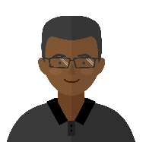
About this guide -
conversations that matter
This toolkit has been designed to support managers and staff in having effective conversations focused on their personal developments and career ambitions. The toolkit is just one of several resources available as part of the wider Care Workforce Pathways support teams in building a supportive culture and empower staff to reach their potential.
Here are some things to remember:
The Care Workforce Pathway for adult social care is an opportunity for a workforce that is driven by a passion for adult social care and making a difference in people’s lives, to also enjoy the opportunities for growth and a professional career in care.
This guidance will help managers and their teams to have career and development conversations that matter.
An effective career conversation will help people to focus on their future at work. It’s a chance for the individual to discuss their current role and hopes for their future career or development in adult social care – whether they want to move up the ranks or not. It’s also a chance for managers to help their team members feel valued, engaged and motivated by their careers.
Meaningful feedback, recognition and support from managers is a crucial part of this.
Thank you for taking the time to reflect and plan for these important conversations.
Manager
“I now understand Sunita’s career goals for the next 6-12 months and we’re working together to develop her action plan.
I’ve also got to know how she prefers to learn and how I can support her to achieve her goals.”
Amir
Line report
“Making time to reflect on my skills and knowledge, has helped me realise the opportunities open to me that can help me become a team leader care.
I agreed with Amir that we’ll review the development plan monthly, so he can continue to support me.”
Sunita

Slide 4
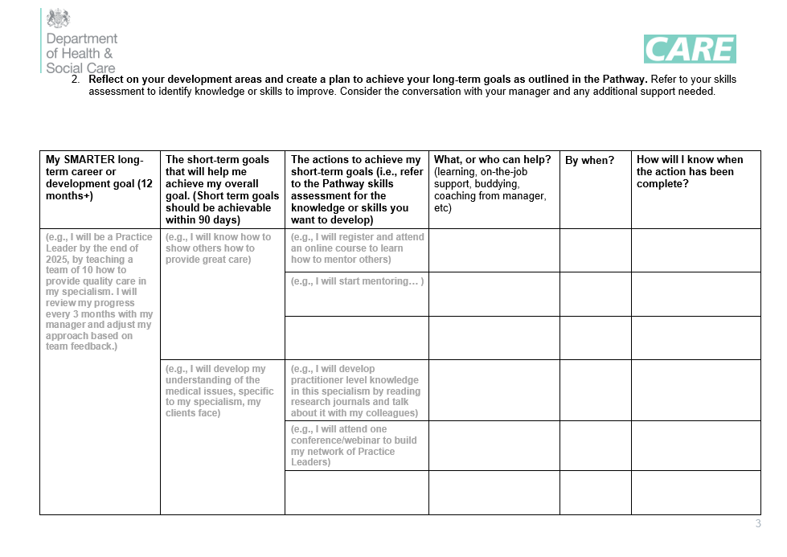
Use this toolkit in conjunction with
the following documents
You can download the skills assessment document and career development plan template from the Skills for Care website.
The skills assessment is an interactive document that helps you to reflect on the skills, knowledge and behaviours and training suggested for your role.
It should be completed by the line report and then the manager, or together. This will give clarity on areas your great at and areas to develop.
The career development plan will capture your career aspirations through a goal you set yourself for the year ahead, and mini-goals and actions to help you along the way.
Consider this a live document that is reviewed and updated regularly, as agreed with your manager.

Slide 5
An example of a timeline for ongoing meaningful career conversations
Career conversations can take place during formal review meetings (see the top row in the diagram below) as well as more informal check-ins (see bottom row). The key to making this work is for managers and members of staff to agree on how they’d like to stay in touch with career development discussions. Informal check-ins are a great way to hear about how your team are developing and putting new skills and knowledge into practice. If your organisation already has a similar process, consider using the Pathway skills assessment document and career development plan template, on the Skills for Care website during the formal review meetings and/or informal check-ins, so an individual’s progress on the Pathway is kept up-to-date.
Career planning and goals
Managers and members of staff meet to discuss career aspirations for the year ahead. This can be captured in a career development plan template and reviewed as agreed by the pair.
Mid-year feedback / appraisal review
Opportunity to check-in with members of staff on the career plan and agree on updates needed.
End of year feedback conversations / appraisal reviews
Review and discussion of the member of staff’s performance during the year, including achievements against the career development plan
Check-in on progress against career plan, as agreed (monthly/quarterly)
Informal meetings between manager and member of staff to continue with career conversations, during appraisal meetings or supervisions.
This is a chance to get to know the team and be part of their development throughout the year.

Slide 6
Summary of the Pathway role categories
to guide career and development conversations
The Pathway offers a structured way to develop skills and experience, not matter what their career aspiration may be. If staff want to consider promotion, you should review and discuss the role category above as a pair. If they want to develop in their current role, and not interested in promotion, you should review their current role category. The Pathway offers opportunities for those who want to be promoted and those who want to develop in-role, helping everyone continuously improve and enhance the quality of care.
Role categories | Description of the role
A – New to Care | This role is the starting point for a career in social care with many opportunities to learn and develop one’s skills and knowledge. You should progress to consolidation of minimum skills from the Level 2 Care Certificate.
B – Care or Support Worker | Moving your practice to a Level 3 standard, potentially through a diploma or apprenticeship route (including setting-specific areas of practice through optional units).
C – Supervisor or Leader | At this level, a member of staff might have progressed to become a team leader. They might have some people management responsibilities and be considering their future career options: to develop practice or to go into management. At this level, they should start to have a clear specialism.
D – Practice Leader | A member of staff will take the lead in supporting others in their setting to develop their own practice, coaching and mentoring them in ways to improve. It will be part of their role to stay at the forefront of practice within their chosen specialism, supporting others to do the same so they can provide the best possible care to the people they support. Progressing to develop knowledge and skills to be an effective practice leader, possibly by completion of a Level 4 specialist qualification.
E - Deputy Manager | At this level, you will likely have people management responsibilities which will include supporting and developing staff to deliver safe and effective care and support. You will be working closely with the Registered Manager to support them in the effective running of the service, supporting with key decision making and acting as manager in their absence. You might be considering your future career options and taking the Level 5 Diploma in Leadership and Management in Adult Care​.
F - Registered Manager | At this level you may still provide direct care and support but will likely be focussed on ensuring the service meets all its regulatory and legal requirements and is providing safe and effective person-centred care and support. You will be responsible for ensuring your staff are effectively trained to deliver high quality care whilst ensuring they are supported, recognised and valued. You’ll be responsible for the day to day running of your service, making informed strategic decisions about how it operates. You will have completed or are in the process of completing the Level 5 Diploma in Leadership and Management in Adult Care​.

Slide 7
Having a career conversation A step-by-step guide

Slide 8
Navigating career conversations:
step-by-step guide
This page outlines the steps for effective career conversations. Detailed explanations for each step can be found on pages 9 - 12
1. Reflect
2. Meet
3. Reflect
4. Check-in
Manager:
Reflect and prepare to meet with line report to discuss career goals and development.
Line report:
Reflect and complete skills self-assessment (ideally, complete with manager as a joint exercise, agreeing best way to do this).
Manager:
Discuss with your line report their career aspirations and agree development areas.
Line report:
Use your self-assessment to discuss your areas of strengths and development, for your career plan.
Manager:
Reflect on how the discussion went, follow up with line report if needed.
Line report:
Reflect on the discussion, update, if required, the career development plan template and share with manager.
Manager:
Meet with line report, frequency as agreed, to check-in on progress against the career plan. Support and encourage them.
Line report:
Update on progress with your career development plan.

Slide 9
Reflect and prepare for the career
and development conversation
Manager
Read the Pathway role category for your line report to understand the skills, knowledge, behaviours and training required
Think of how you want your line report to feel about their career using the Pathway (inspired, empowered, supported)
Think of empowering coaching questions to guide the conversation and help them to develop a meaningful development plan when you meet (see pages 13-15 for suggestions. Alternatively, you can use the GROW model questions instead if you wish, pages 16-17)
Line report
Complete the skills assessment for your role, and consider the following to help you complete the Career Development Plan (see Skills for Care website for these toolkits):
How do I want to develop and/or progress? (next 3 months/6 months/12 months)
Which skills and knowledge areas am I strong at?
What are my areas for development?
Is there anything I can do to improve the quality of care I provide?
Tip 1: The role category skills self-assessment for the line report can be completed as a joint exercise

Slide 10
2. Meet to discuss and align on career
goals and/or in-role development
Manager
Check-in with the individual on their understanding of the Pathway and agree desired outcome from the conversation
Establish an open feel, putting the individual at ease and showing interest – ask how are they.
Be present and listen. Give the individual space to share the self-assessment and reflections on career aspirations to address gaps
Provide realistic ways to achieve goals, based on on-the-job learning, learning through others, and training
Ask the individual how often to meet to check and support with the career development plan
Line report
Share your reflections on what an energising career in care looks like.
Discuss your completed skills-assessment
Discuss the career goals you’d like to do achieve and what this would mean for your role. Make sure your goals are SMARTER (specific, measurable, achievable, realistic, time-bound, exciting, recorded)
Agree how often you’d like to meet with manager to continue career conversation

Slide 11
3. Reflect on the career conversation
Manager
Reflect on the conversation – what worked well, what could have gone better, and what will you do next time?
Encourage the individual to regularly refer to and update their career development plan
Member of staff
Reflect on the conversation – worked well, even better if, what you will do next time
Reflect on the goals set in your career development plan, and progress made to date

Slide 12
4. Check-in on the career development
plan, as agreed
Manager
Follow-up with individuals on how their plan to achieve their goals is going. Use the GROW model to guide you – see page 16-17 - (do goals need to be revised, new goals, additional actions for plan etc)
Understand potential blockers to the individual accomplishing their goals, and how they can feel empowered to address them
Over time, collate feedback from others the individual has worked with, to understand how new skills and knowledge are put into practice
Line report
Share with your manager how things are going with your career plan (working well and not so well) and where guidance is needed from manager
Consider next steps (e.g., revised or new goals, agreed actions to continue with plan and goals)
Over time, ask others how you’re performing against your goals, to see where you excel and where you might need support

Slide 13
For managers: Structuring career conversations
Using coaching style questions

Slide 14
Career and development conversation
question bank for managers
Career conversation openers that can bring the Pathway and skills self-assessment to life
What would you like to gain from this conversation?
How do you feel about what the Pathway has to offer for your career and development? What areas are clear or need more clarity I can help with?
What makes your work important to you?
What do you want to learn more about?
What do you want to achieve?
Understanding an individual’s skills and knowledge, strengths and motivations
What parts of your job do you love the most? What makes you say that?
What have been the best times at work for you in the last year?
What are the things you often get positive feedback about?
Understanding an individual’s areas for development as per the self-assessment and to achieve career aspirations
Are there aspects of your work you feel you could do better with the right development or any areas you struggle with?
Are there aspects of the current job (technology, skills needed etc) that require you to develop new or refresh existing skills or knowledge?
What things / activities do you find draining or de-energising?

Slide 15
Career and development conversation
question bank for managers
Career development planning questions to consider
Based on our chat, what are the top knowledge or skill gaps of the Pathway you need to include in your plan? What’s a realistic timeframe for the actions?
Looking at the Pathway, how clear are we on the career and development options available for you?
Are there opportunities for on-the-job learning (with supervision if required) and coaching/mentoring from others to address areas for development?
Are there any concerns you have with seeing the plan through? How can I support you?
Agreeing next steps
What are the first thing you will do to move forward against your plan?
What will be the quick wins?
What support do you need from me/others?
When shall we meet again to review progress and check if actions on plan are still correct for your career development?

Slide 16
Career and development conversation
question bank for managers
Questions for check-in once the plan is agreed
How are things going?
What new skills and knowledge have you learned (though training, on-the-job, coaching etc) that have strengthened your overall role capabilities?
How do you feel about your development in care?
Are there goals and actions on the plan we need to review to change or maintain?

Slide 17
Using the GROW model to set
short term goals
Setting short-term actions in your role enhances focus, motivation, and productivity by breaking down larger goals into manageable tasks. It also allows for quick wins, regular assessment, and adaptability, ensuring steady progress and alignment with induvial priorities.
Short-term goals provide a powerful tool for development and progression. They should be considered as stepping stones towards your long-term career and development goal.
Ideally, a short-term goal will be achievable within the next 90 days. They are ideal for projects, career and personal ambitions, and for quarterly targets.
By following the GROW model during a conversation, you can help your member of staff develop goals and explore how to achieve them.
Goal: use SMARTER (specific, measurable, achievable, realistic, time-bound, exciting, recorded) to create something detailed and compelling
Reality: how is it now? Understand the baseline or the starting point
Options: explore all possibilities, nothing is too ridiculous at this stage
Will (or Wrap-up): Identify 3 things off the Options list that your member of staff can commit to with an 8-10 on a 1-10 scale of certainty
G
R
O
W

Slide 18
Using the GROW model to set
short term goals
When using the GROW Model, you can help to plan into the future, turning your short-term actions into stepping stones which help you reach a longer-term aspiration. You can use this model during your first conversation and/or as part of ongoing check-ins.
GOAL | REALITY
What is the aim of this discussion? What do you want to achieve in the long term? What does success look like? How much personal control or influence do you have over your goal? What would be a milestone on the way? What is a short-term goal on the way? When do you want to achieve it by? Is that possible, challenging, and attainable? How will you measure it? | What is happening now? (What, when, where, who, how much, how often) Who is involved (directly and indirectly) When things are going badly on this issue, what happens to you? What is the effect on others? What have you done about this so far? What results did that produce? What’s missing in this situation? What do you have you are not using? What’s holding you back?
OPTIONS | WILL (or Wrap up)
What could you do now? What else could you do? What if… (Time, power, money, etc.) were no barrier? What advice would you give to a friend in a similar situation? Would you like another suggestion? What would you do if you knew you could not fail? What would you do if your life, or the lives of others, depended on it? What have you seen work for others in a similar situation? | Which option or options will you choose now? To what extent does this meet all your objectives? How will you measure success? When are you going to start and finish each step? What could hinder you in taking your first steps? What support do you need and from whom? What could I do to support you? What commitment on a scale 1 – 10 do you have to taking these agreed actions? What prevents this from being a 10? What could you do or alter to raise your commitment closer to 10?

