Slide 1


Culturally Appropriate Care
Part 3: Supporting relationships and people who are LGBT+
ESCC Adult Social Care Training Team 2022

Slide 2
NOTE: This is part 3 of 3 training sessions.
Aim: To know about culturally appropriate care, focusing on supporting relationships and people who are LGBT+
Outcomes: By the end of this session you will;
know what ‘culturally appropriate’ care means
understand why the Covid-19 pandemic may increase barriers around culturally appropriate care
identify barriers for people with learning disabilities/and or autism in forming relationships
recognise good practice principles that help to promote sexual safety and support people’s sexuality in adult social care.
be aware of barriers that people from LGBT communities face
be familiar with LGBT terminology and acronyms
know about equality rights in health and social care for people who are transgender

Slide 3
Domestics
Refreshments
Comfort breaks (including location of toilets)
Smoking
Fire procedures
Mobile phones
Ground rules
For online learning
Online instructions such as cameras, microphones, use of messaging box, etc
Introductions

Slide 4
What do we mean by ‘culturally appropriate care’?
Culturally appropriate care (also called 'culturally competent care') is being sensitive to people's cultural identity or heritage.
Cultural identity or heritage can cover a range of things. For example:
  Ethnicity
  Nationality
  Religion
  Sexual orientation (for example, lesbian, gay and bisexual people)
  Gender identity (for example, transgender people)

Slide 5
Culturally appropriate care during the coronavirus (COVID-19) pandemic…
People using services may:
have less contact with people that understand and affirm their culture - for example, family and friends
have no opportunity for contact with their culture or community outside their home
spend more time with people who do not share their culture - for example in a care home
experience more life events that have cultural significance - for example, they may be at the end of their life or lose someone close to them

Slide 6
Human Rights Act
Supported by the Mental Capacity Act 2005 and the right to make decisions, people with learning disabilities and autism have the same rights as anyone else under the Human Rights Act 1998, including:
Article 8 – Right to a private and family life (including decisions about your appearance, your relationships, and your sexual orientation)
Article 9 – Freedom of thought, belief, and religion (the right to choose and change your beliefs, including your beliefs about sexuality, sexual and gender identity, and relationships)
Article 12 – Right to marry and have a family

Slide 7
Mental Capacity Act 2005
The Mental Capacity Act is intended to both empower and protect everyone, including people with learning disabilities and/or autism.
From the age of 18 (or from 16 years in the case of sexual intercourse and medical consent) people with a learning disability and/or autism have the right to make their own decisions.
This right includes deciding to engage in lawful consensual sexual activity and is only constrained where a person is assessed under the Mental Capacity Act 2005 as lacking the capacity to consent.
Notes:
w

Slide 8
Relationship barriers
Many people with learning disabilities/and or autism are deprived of the opportunity to develop their sexual identity, expression, and relationships, or enjoy family life in the same way as anyone else.

Slide 9
Relationship barriers
What barriers might people with learning disabilities/and or autism face in forming relationships?
This activity can be done as
A whole group discussion (via zoom / Microsoft Teams)
By individuals or small groups in a classroom setting (see downloadable activity sheets)

Slide 10
What internal and external barriers do YOU face in forming relationships?
Now, think of someone you support. What internal and external barriers do they face?
Person
you
support
You

Slide 11
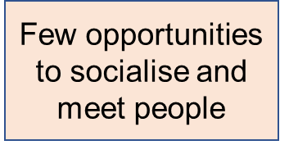

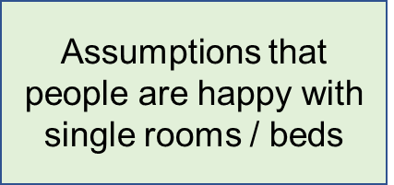
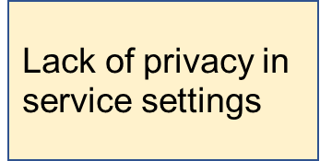
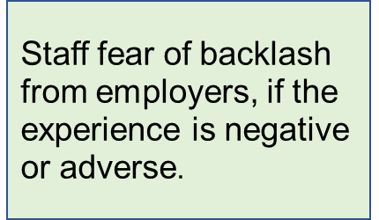
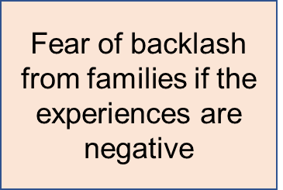

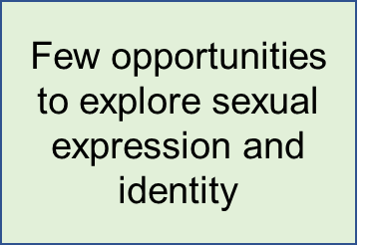
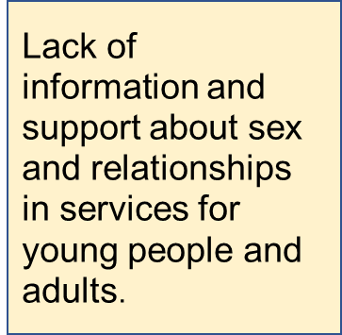
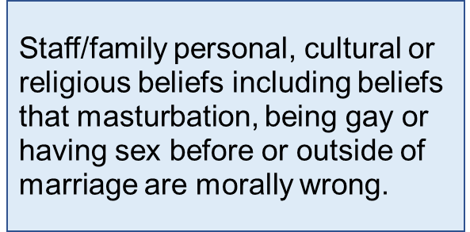
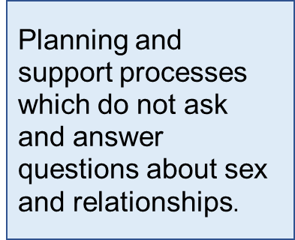
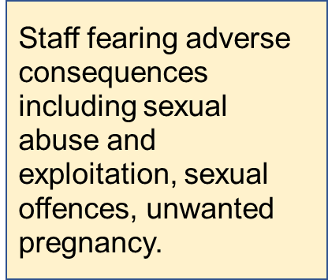

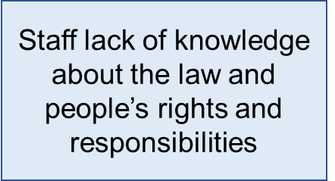

Staff / families deterring behaviour
Person
you support
Covid-19
Learning disability
Lack of technology / support for online dating
Low confidence
Autism
shyness

Slide 12
Sexual safety and sexuality
CQC have produced a report which aims to raise awareness of issues of sexual safety and sexuality in adult social care.
It looks at how people using services are kept safe from sexual incidents, and how they are supported to express their sexuality.
A person-centred approach to care, which considers people’s holistic needs, will include an understanding of a person’s sexual identity and how they should be supported to appropriately express their sexuality in a way that supports and empowers them and protects them from harm.
CQC report - Promoting sexual safety through empowerment

Slide 13
Principles of good practice
Leaders should promote a culture of openness that allows people to both discuss issues of sexuality and raise issues of sexual safety, as part of a holistic approach to good person-centred care.
People receiving adult social care are entitled to the same human rights as anyone else, and should be afforded the same dignity, choice, family life, privacy and respect, and should be able to feel safe from sexual harm.
People who use services should be central to conversations about their needs and choices. Where seen as supportive and agreed to, family members, carers and advocates can also be included.
Assessments should include information about people’s sexuality needs (including current relationships, sexual orientation and understanding of sexual health, where appropriate).
Care plans should accurately reflect these assessments and note the needs and wishes of people.
Training should include supporting staff to have informal, everyday conversations about sexuality and sexual safety.
Recruitment and organisational values should have a human rights focus.
Providers should work with relevant community groups to give staff and people who use services support and access to information on sexual safety and sexuality.
CQC report - Promoting sexual safety through empowerment

Slide 14
LGBT+
Homosexuality was illegal till 1967 so many people lived in fear of being caught, losing their jobs and even their families.
Being lesbian, gay, bisexual or trans is about more than your sex life or whether you are in a relationship or not.
It shapes the way you have experienced life, your interests, likes, dislikes, humour, family, friendships and attitudes. It might also inform the books you read, films you watch and music you enjoy.
safe_to_be_me.pdf (ageuk.org.uk)

Slide 15
Can you imagine what it would be like to…
Spend your childhood feeling different but not knowing why
Talk about a romantic weekend without ever mentioning your partner’s name or gender?
Be given electric shock treatment or medication that makes you vomit to ‘cure’ you of your love for someone?
Never hold hands or kiss in public because you might be beaten up?
Have to hide books, clothes, photographs or DVDs when you have a visitor to your home?
Welcome to the reality of many people who are lesbian, gay, bisexual or trans (LGBT), particularly those who were born before 1950.
safe_to_be_me.pdf (ageuk.org.uk)

Slide 16
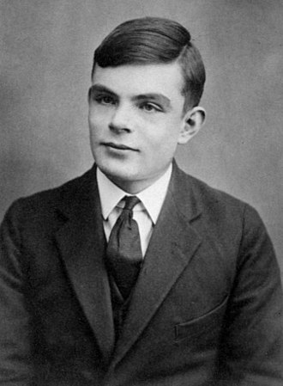
Looking
back in time
Alan Turing was an English mathematician, logician and cryptographer and was responsible for breaking the Nazi Enigma code during World War II. His work gave the Allies the edge they needed to win the war in Europe, and led to the creation of the computer
In 1952 Alan Turing was prosecuted for ‘homosexual act’s’. He accepted hormone treatment, so called ‘chemical castration’ as an alternative to prison.
In 2009, following an internet campaign, British Prime Minister Gordon Brown made an official public apology on behalf of the British government for "the appalling way he was treated".
The ‘Alan Turing Law’ is now an informal term for a 2017 law in the United Kingdom that retroactively pardoned men cautioned or convicted under historical legislation that outlawed homosexual acts.

Slide 17
HIV and stigma
HIV is a medical condition that carries a lot of stigma, usually because people lack information about it or they make moral judgements about how someone has contracted HIV.
This is because HIV is mainly transmitted through sex and can be linked to activities such as injecting drugs.
Stigma is often borne out of fear and can take many forms, including:
hostility
physical or verbal abuse
someone being avoided or excluded from activities they used to take part in.
People living with HIV are protected by the Equality Act 2010 from the time they’re diagnosed. This makes it illegal for you to be discriminated against on grounds of disability, which includes living with HIV.
Stigma | Terrence Higgins Trust (tht.org.uk)

Slide 18
What terminology?
Terminology around race, ethnicity and sexuality evolves continuously. It is important that you learn about preferred terminology used in your organisation and with the individuals you support. It is also important to remain actively conscious of changes.
The best advice when working in a person-centered way is to ask the person which terms, they prefer…

Slide 19
What terminology?
Terminology around race, ethnicity and sexuality evolves continuously. It is important that you learn about preferred terminology used in your organisation and with the individuals you support. It is also important to remain actively conscious of changes.
The best advice when working in a person-centered way is to ask the person which terms, they prefer…
Lesbian - Refers to a woman who is emotionally and/or physically attracted to other women.
Gay - Refers to someone who is emotionally and/or physically attracted to people of the same gender.
Some women prefer to refer to themselves as a gay woman rather than lesbian, although the word gay is most commonly used in reference to men.
https://sexualhealthdg.co.uk/lgbt-terminology.php

Slide 20
Transgender - An umbrella term for those whose gender identity or expression differs in some way from the gender assigned to them at birth and conflicts with the 'norms' expected by the society they live in. Included in the overall transgender umbrella are transsexual people, non-binary gender identities and cross-dressing people.
Transsexual - When a person's gender identity is different from the gender they were assigned at birth based on their biological sex. Transsexual people may have medical treatment, such as hormone treatment or surgery to bring their physical appearance more into line with their gender.
Non-binary - Non-binary people are those who don't feel male or female. They may feel like both or like something in between.
They may have a gender that changes over time or they may
not relate to gender at all.
Bisexual - A person who is emotionally and/or physically attracted to people of more than one gender or regardless of gender.
Heterosexual/Straight - Used to describe people who are emotionally and/or physically attracted to people of the 'opposite' gender.
Cisgender - Individuals who have a match between the gender they were assigned at birth, their bodies and their personal identity. In other words those who are not, or do not identify as transgender.
https://sexualhealthdg.co.uk/lgbt-terminology.php

Slide 21
Pansexual - A person who is emotionally and/or physically attracted to people of more than one gender or regardless of gender. Some people use the term pansexual rather than bisexual in order to be more explicitly inclusive of non-binary gender identities.
Queer - An umbrella term used for diverse sexual orientations or gender identities that are not heterosexual and do not fit within a gender binary. It may be used to challenge the idea of labels and categories such as lesbian, gay, bisexual, or transgender. It is important to note that it is an in-group term, and
may be considered offensive to some people.
https://sexualhealthdg.co.uk/lgbt-terminology.php

Slide 22
Acronyms
LGBT - Acronym for Lesbian, Gay, Bisexual, Transgender
LGBTI - Acronym for Lesbian, Gay, Bisexual, Transgender, Intersex
LGBTQ - Acronym for Lesbian, Gay, Bisexual, Transgender, Queer or Questioning
LGBT+ - The + is to be inclusive to everyone that feels part of the LGBTQ+ community but don’t feel like they fit into the groups listed in LGBTQ
FTM - Female to male transsexual person; a trans man.
MTF - Male to female transsexual person; a trans woman.
LGBT+

Slide 23
Easy read
The use of inclusive language must always be considered.
The acronym LGBTQ+ may not be fully understood by some individuals with learning disabilities.
Consider using easy read booklets, such as this to support understanding: LGBTQ Easy Read (changepeople.org)

Slide 24
“He” or “She”?
Using the appropriate pronouns when talking to someone who is transgender works on the basis of respect for the individual.
Generally the name the person chooses to use indicates their gender preference. So, a transgender person called Steve would be referred to as "he", while another called Rachel would be "she".
If you are unsure, it's best to ask the person politely how they wish to be known.
This is especially so if you suspect someone identifies as non-binary, in which case a neutral term like "they" may be more appropriate.

Slide 25
Transgender people – equality rights
A healthcare or social care provider which is providing separate services or single-sex services must not exclude a transgender person from the services appropriate to the sex in which the transgender person presents (as opposed to the sex recorded at birth) unless they can objectively justify this.
Where a transgender person is visually and for all practical purposes indistinguishable from someone of their preferred gender, they should normally be treated according to their acquired gender unless there are strong reasons not to do so.
Equality rights in health and social care services.pdf

Slide 26
Healthcare and social care service providers need to be aware that transgender people may need access to services relating to their birth sex which are otherwise provided only to people of that sex.
For example, a transgender man may need access to breast screening or gynaecological services.
In order to protect the privacy of all users, it is recommended that the service provider should discuss with any transgender service users the best way to enable them to have access to the service.
A service provider may have a policy about providing its service to transgender users, but this policy must still be applied on a case-by-case basis.
It is necessary to balance the needs of the transgender person for the service, and the disadvantage to them if they are refused access to it, against the needs of other users, and any disadvantage to them, if the transgender person is allowed access.
This may require discussion with other service users (maintaining confidentiality for the transgender service user). Care should be taken in each case to avoid a decision based on ignorance or prejudice.
Equality rights in health and social care services.pdf

Slide 27
What are the rules around women-only spaces?
There has been debate about the rights of transgender people and there is a range of views as to how society can best balance the needs of different groups.
Much of the debate has focused on access to women-only spaces such as toilets, changing rooms, domestic violence refuges and prisons.
Under the Equality Act 2010, no-one should be discriminated against because they are transgender.
bbc.co.uk

Slide 28
A person does not need to have undergone any specific treatment or surgery to be protected from this discrimination.
Single-sex service providers can choose to exclude transgender people where there are ''proportionate means of achieving a legitimate aim‘’.
An example given by the Equality Act is that organisers of group counselling for female sexual assault victims could exclude a trans woman if they judged that clients would be unlikely to attend the session if she was there.
However, refusing a trans woman entry to a pub's female toilet is likely to be unlawful.
Good practice example: Support for a transsexual woman at a supported living provider
M is a transsexual woman with learning needs.
She is not able to go back to her family home and has no contact with her Dad and minimal contact with her Mum. Her Nan is the most involved and supportive member of the family.
She is currently transitioning and was unhappy with the lack of support in her original supported living placement.
M’s new supported living provider embraced her choice to dress and act as a woman.
They worked with the specialist sexual health nurse to support her to investigate a surgical and medical intervention to transition to her preferred gender.
This is progressing slowly as her clinic needs to see that M is consistent in her behaviour and decisions. In the meantime, M has grown in confidence and has taken on a job with the local police.
Example from CQC regulatory work and engagement

Slide 29
Care planning
A care plan that neglects to include this huge part of a person’s individuality is incomplete and is likely to fall short of meeting that person’s needs.
Good practice in action: care planning examples
“George would like to have his subscription to Gay Times continued. He enjoys having some of the articles read out to him. He likes going through the ‘personal ads’ column thinking about who he might like to contact.”
“Rosaria would like to go out to a local gay pub with three of her closest female friends on a monthly basis.”
“Eric still enjoys a sexual relationship with his boyfriend Charles and so when there is a ‘Do not disturb’ sign on the door, this should be strictly respected.”
The whole of me - Age Concern

Slide 30
Good practice example: Supporting people who identify as LGBT+
An older man lived in a care home. He had a photo on his table, which had been taken when he was younger and in the armed forces.
The photo showed another man. His care worker realised it might have some significance and asked him gently about the picture.
Over time the gentleman felt increasingly able to open up and talk about his relationship with the man in the photo.
He had never told his family about it and had kept it a secret for his whole life. Only in the care home was he finally able to talk openly about his sexual orientation, thanks to the relationship and trust built with the care worker.
Example from CQC regulatory work and engagement

Slide 31
Stonewall
Stonewall have been campaigning as part of a global movement since 1989 and have helped create transformative change in the lives of LGBTQ+ people across communities in the UK.
Stonewall commissioned YouGov to survey a sample of 1,050 heterosexual and 1,036 lesbian, gay and bisexual people over the age of 55 across Britain.
The survey asked about their experiences and expectations of getting older and examined their personal support structures, family connections and living arrangements. It also asked about how they feel about getting older, the help they expect to need, and what they would like to be available from health and social care services.

Slide 32

The survey showed that lesbian, gay and bisexual people over 55 are:
More likely to be single.
More likely to live alone.
Less likely to have children.
Less likely to see biological family members on a regular basis.
More likely to be estranged from their biological family compared to heterosexual people often because their biological family do not approve of their sexual orientation.
Care and support staff should never assume a patient’s sexual orientation
Care and support staff should not discuss their personal views about lesbian, gay and bisexual
people or issues
Care and support staff should use open questions to encourage service users to be open about their sexual orientation and needs.
Care and support staff should provide information to patients on opportunities for them to engage with other lesbian, gay and bisexual people socially.

Slide 33
Stonewall recommends that:
Care homes should apply the same polices and procedures to same-sex couples wanting to live together in care homes as heterosexual couples.
Same-sex couples should be allowed private time or allowed to show affection for one another as is the case for heterosexual couples.
Care homes should develop clear policies on what is appropriate and inappropriate behaviour from patients. Care homes should deal firmly but sensitively with incidents of homophobia from patients.
Staff should be trained to understand the needs and circumstances of older lesbian, gay and bisexual patients and how to provide them with good quality care.
Lesbian, gay and bisexual residents should be supported to access opportunities to socialise and meet other lesbian, gay and bisexual people to help them maintain social support networks.
Care home staff should ensure older lesbian, gay and bisexual people have stipulated who should be given decision making power in the event that they are unable to make decisions about their care for themselves.
Care homes should make their environments more welcoming by displaying images, posters and materials that reflect lesbian, gay and bisexual people.

Slide 34
Working with lesbian, gay, bisexual and transgender people: people with learning disabilities: Richard's story
https://www.scie.org.uk/lgbtqi/video-stories/learning-disabilities

Slide 35
Key messages from the film:
When providing services to an LGBT individual with a learning disability there will be the need to balance both responsibility toward the individual’s rights and the need to contain risks.
Social exclusion and isolation are key factors to LGBT lives.
Providers need to be trained to be able to sensitively discuss relationships and sexuality with individuals and the impact this has upon person-centred and personalised care.
The inclusion of LGBT communities and individuals in the commissioning of care services is key to creating a more inclusive and diverse sector.
People with learning disabilities have sexual desires and different sexual orientations just like anyone else.
https://www.scie.org.uk/lgbtqi/video-stories/learning-disabilities

